Slide 1

Team 55: National Firefighter Registry
In Collaboration with CDC-NIOSH
11/29/2020

Slide 2
Agenda
Project Goals and Requirements
Team Roles and Contributions
Research on Design
Demonstration
Project Status and Gantt Chart
Future Plans and Opportunities

Slide 3
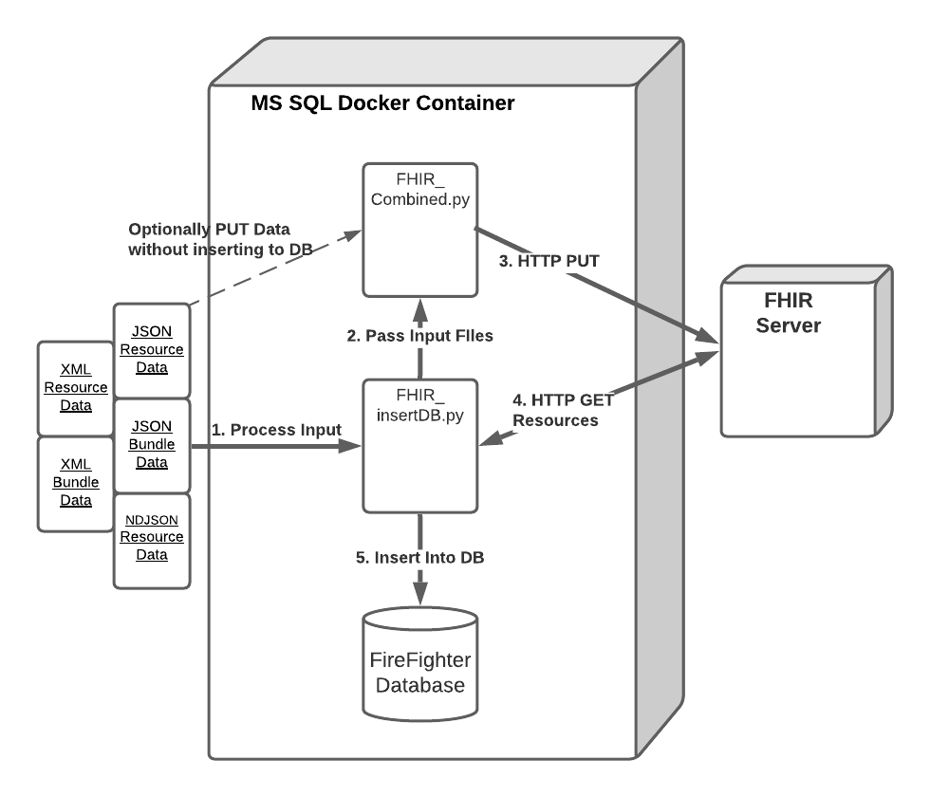
Project Goals and Requirements

Slide 4
Team Roles and Contributions
Team 55 Members:
James Davis
Haolong Yan
Rahul Nowlakha
Joe Kurokawa
Traver Clifford
Eric Mammoser
CDC Mentors:
Jill Raudabaugh
Breanna Newton
GT Mentor:
Elizabeth Shivers

Slide 5
Research on Design
Scope of project defined by CDC
Python libs:
Considered fhir-client.py to handle interaction with FHIR server
Didn’t support XML data => settled on handling own HTTP request
FHIR server to use
Public
Support R4
Mapping FHIR resources to
Worked through HL7 FHIR standard and made tentative mapping; aligned with mentor

Slide 6
Project Status and Gantt

Slide 7
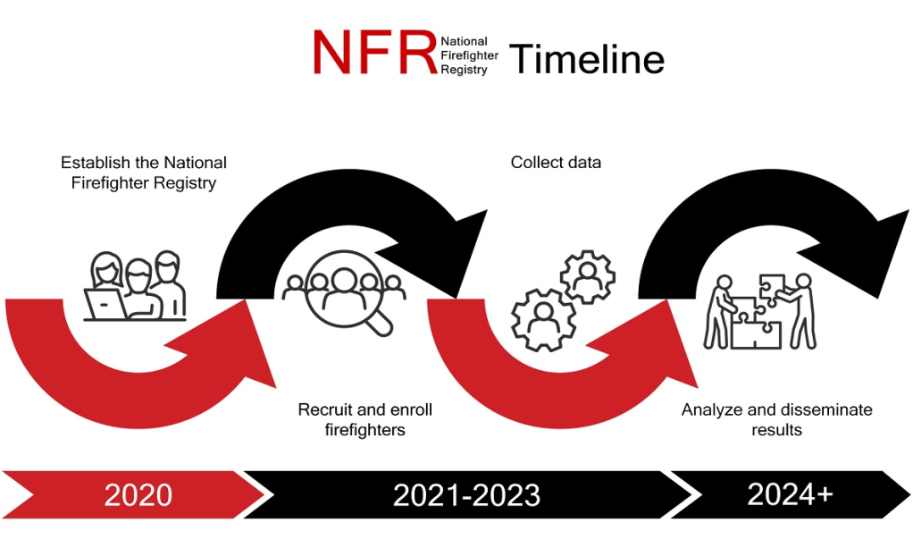
Future Plans and Opportunities
CDC to use our findings to help inform their design
Source: https://www.cdc.gov/niosh/firefighters/registry.html

